Slide 1
Firewall/IPS

Slide 2
What is Firewall
The firewall is inserted between the premises network and the Internet to establish a controlled link and to erect an outer security wall or perimeter.
The aim of this perimeter is to protect the premises network from Internet-based attacks and to provide a single choke point where security and auditing can be imposed.
The firewall may be a single computer system or a set of two or more systems that cooperate to perform the firewall function

Slide 3
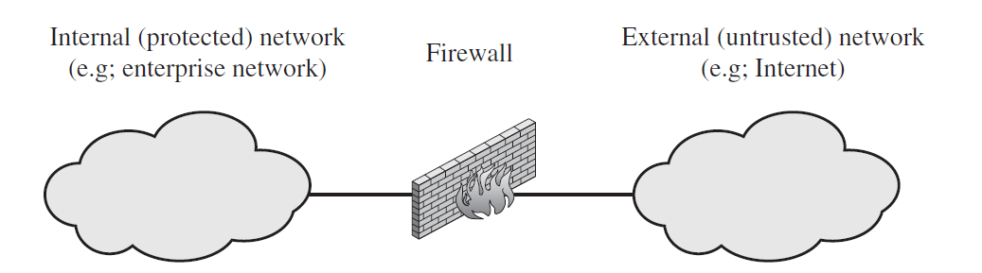
What is Firewall

Slide 4
Design goals for a firewall
All traffic from inside to outside, and vice versa, must pass through the firewall
Only authorized traffic, as defined by the local security policy, will be allowed to pass
The firewall itself is immune to penetration.

Slide 5
Characteristics that a firewall access policy could use to filter traffic
IP Address and Protocol Values: Controls access based on the source or destination addresses and port numbers, direction of flow being inbound or outbound, and other network and transport layer characteristics
Application Protocol: Controls access on the basis of authorized application protocol data
User Identity: Controls access based on the users identity, typically for inside users
Network Activity: Controls access based on considerations such as the time or request, e.g., only in business hours; rate of requests, e.g., to detect scanning attempts; or other activity patterns

Slide 6
Types of Firewalls
Packet filtering firewall
Stateful inspection firewall
Application proxy firewall
Circuit-level proxy firewall

Slide 7
Packet Filtering Firewall
A packet filtering firewall applies a set of rules to each incoming and outgoing IP packet and then forwards or discards the packet.
Source IP address
Destination IP address
Source and destination transport-level address
IP protocol field
Interface

Slide 8
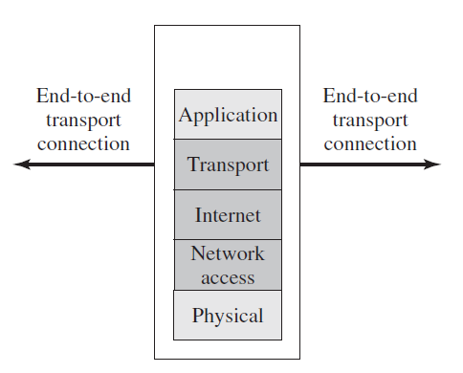
Packet Filtering Firewall

Slide 9
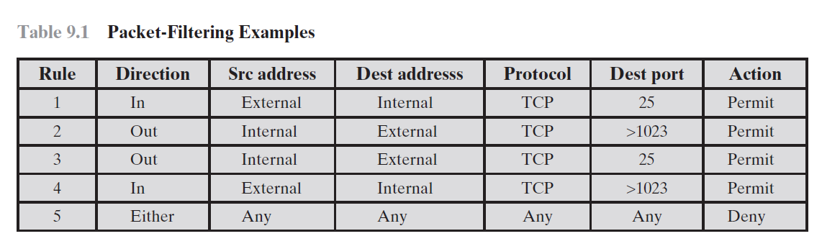
Packet Filtering Firewall

Slide 10
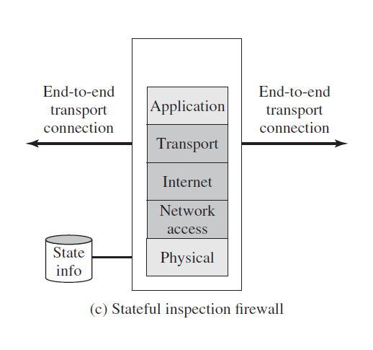
Stateful inspection firewall

Slide 11
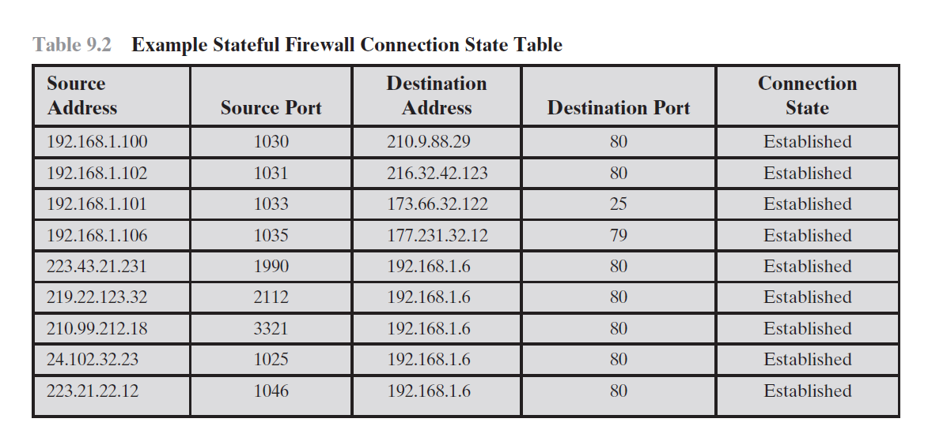
Stateful inspection firewall

Slide 12
Application proxy firewall
An application-level gateway, also called an application proxy, acts as a relay of application-level traffic. The user contacts the gateway using a TCP/IP application, such as HTTP/FTP,

Slide 13
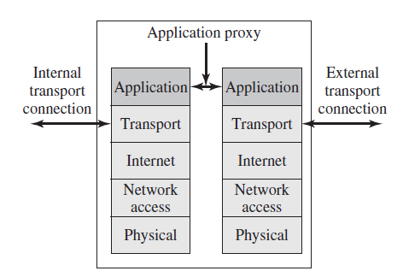
Application proxy firewall

Slide 14
Circuit-level proxy firewall
As with an application gateway, a circuit-level gateway does not permit an end-to-end TCP connection; rather, the gateway sets up two TCP connections, one between itself and a TCP user on an inner host and one between itself and a TCP user on an outside host
An example of a circuit-level gateway implementation is the SOCKS

Slide 15
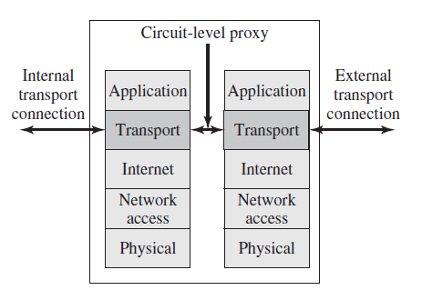
Circuit-level proxy firewall

Slide 16
Firewall Basing
Bastion Host
Host-Based Firewalls
A host-based firewall is a software module used to secure an individual host.
Personal Firewall
A personal firewall controls the traffic between a personal computer or workstation on one side and the Internet or enterprise network on the other side

Slide 17
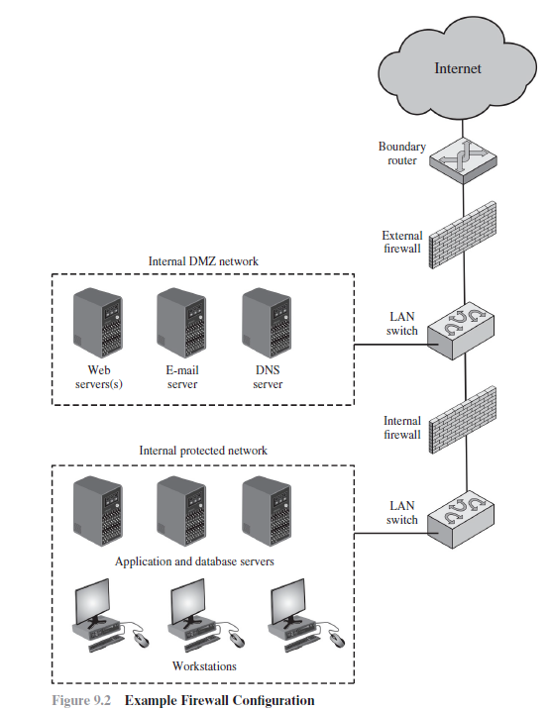
Firewall Location and Configurations

